Slide 1


""Perceptions of My Personality"
Bishal lamichhane
16th aug 2023

Slide 2
Introduction
Objective: Understand how those close to me think about my personality
Exploring how my personality traits are perceived by my nearer ones

Slide 3
Objective and Methodology
Objectives:
Identify common personality traits attributed to me by friends, family, and colleagues
Gain insights into how I am viewed by those closest to me
Methodology:
15 participants from various spheres of my life
Structured interviews with open-ended questions
Thematic analysis to identify recurring patterns

Slide 4
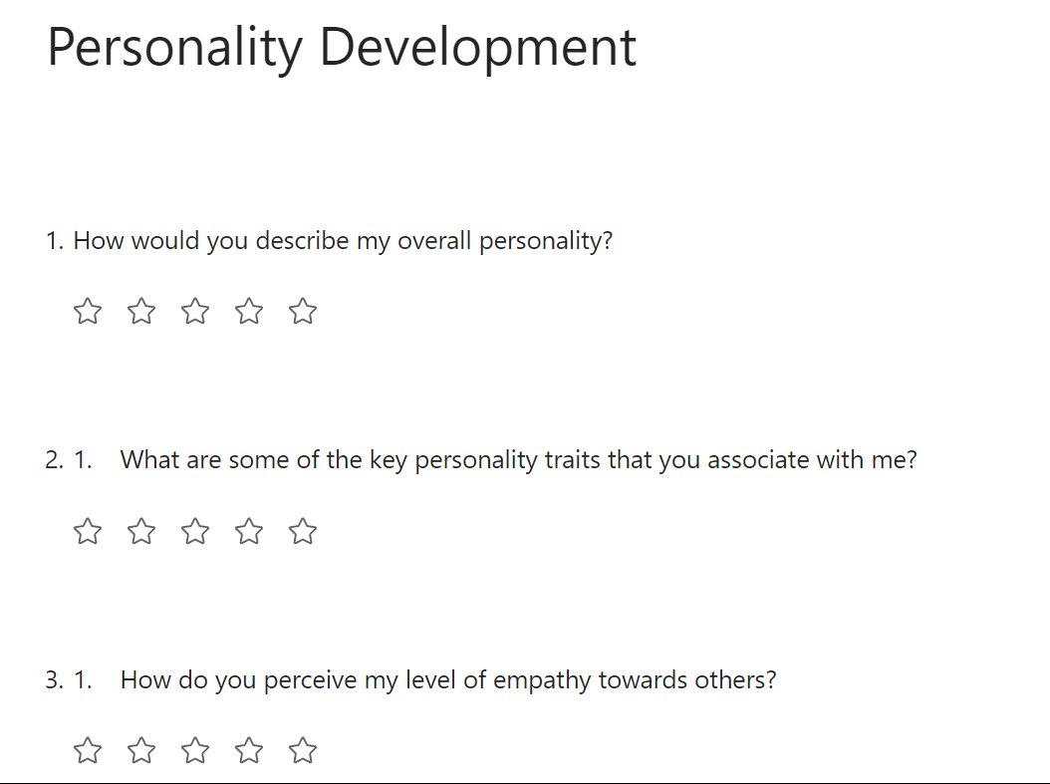
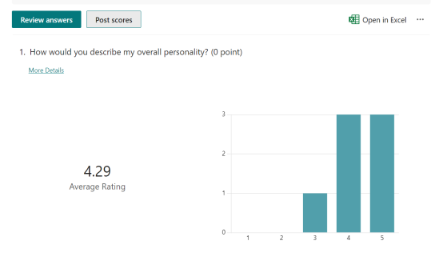

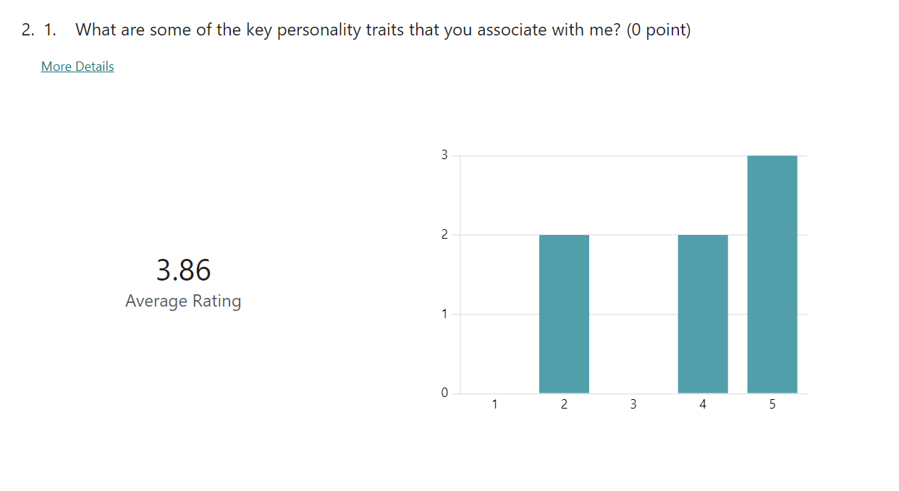
picture

Slide 5
Common Personality Traits
Empathy:
Understand and share others' feelings
Sensitive and genuinely concerned
Reliability:
Trustworthy and dependable
Fulfill commitments and provide support
Optimism:
Positive and hopeful
Maintain positive outlook, inspire optimism

Slide 6
Cont…. Traits
Creativity:
Creative and innovative mindset
Think outside the box, approach challenges uniquely
confident and forceful behaviour :
Express opinions confidently
Effective communication, standing up for beliefs
Sense of Humor:
Bring laughter and lightness to interactions
Make others smile, create a positive atmosphere

Slide 7
Conclusion & Implications
Conclusion:
Self-awareness, personal growth, stronger relationships
Implications:
personal growth
Foster stronger interpersonal relationships
Develop positive personality traits and address areas for improvement

Slide 8


